Slide 1
Next Growth for Japan’s Startups.
Next Innovation for the World.
© 2018 Ministry of Economy, Trade and Industry.

Slide 2
Vision
Next Growth for Japan’s Startups.
Next Growth for the World.
In Japan, over 10,000 startups are exploring new frontiers of business opportunities,
but only a few have succeeded in the global market.
J-Startup is an initiative to concentrate both our public and private resources to support those startups with high potential.
Our goal is to create foster global startup players, providing new values to the world.
The successful Japanese startups from the J-Startup initiative will hopefully bring social respect to enthusiastic entrepreneurship and empower Japan’s startup ecosystem.
© 2018 Ministry of Economy, Trade and Industry.

Slide 3
About
The J-Startup initiative aims to create successful, cutting-edge Japanese startups in the global market. Those successful startups are expected to bring new values to the world, and empower Japan’s startup ecosystem.
Select
J-Startups
Go Global
About 10,000 Startups
Connect
Overseas Expansion
（Conference etc.）
Large Corporations,
VCs, Accelerators,
Government Organizations
Select
Connect
Go Global
Select
Connect
Go Global
民間のトップ支援者の推薦で
潜在力のある企業を選出
支援コミュニティの形成
政策支援、民間支援とつなげる
日本代表としての
グローバル展開を支援
Top VCs and Accelerators recommend startups with great potential.
Build up support community.
Connect public/private support.
Support global challenge as national representative startups.
© 2018 Ministry of Economy, Trade and Industry.

Slide 4
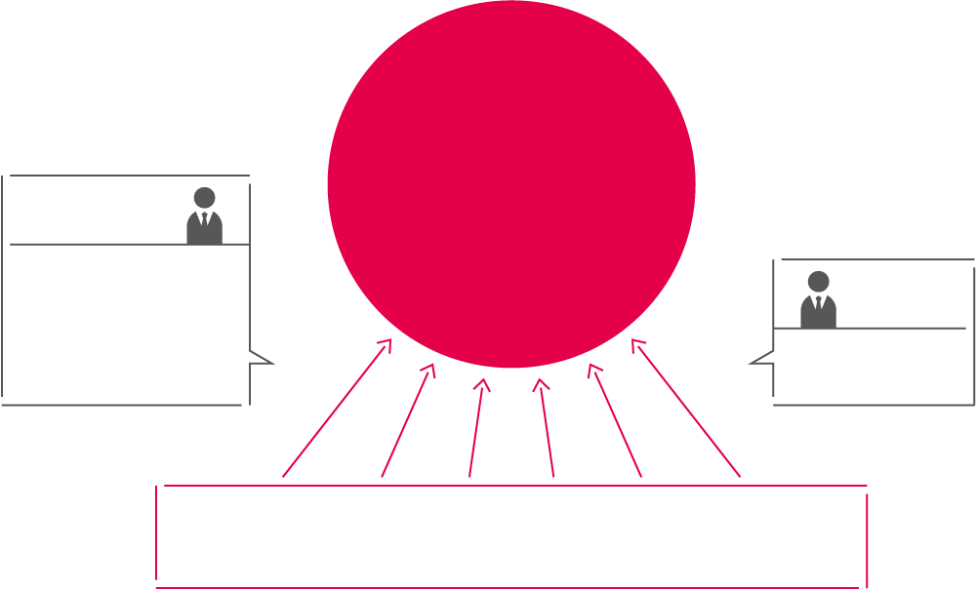
Select
The recommendation members (consisting of top VCs, accelerators, and corporate VCs) choose startups from the view of originality, potential and mission setting, in the fields of real tech, platforms, and SDGs. The startups are then endorsed by the review members (consisting of scholars and experts), before being appointed by the government.
Recommendation Members
J-Startups
J-Startup企業
Criterion
□ Mission
□ Originality
□ Growth Possibility etc.
Scrutineers
Scholars, and
Experts.
About 10,000 active startups in Japan
Deep tech, Platformer, SDGs
© 2018 Ministry of Economy, Trade and Industry.

Slide 5
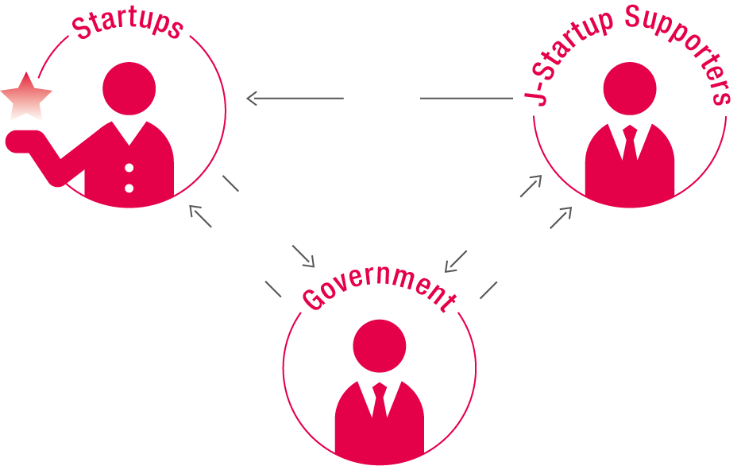
Connect
J-Startup support community will provide private and public support to the selected startups.
The support community is mainly formed by VCs, Accelerators, large corporations and government organizations.
Private Support
Request
Request
Public Support
Request
Large corporations, VCs,
Accelerators
政府の支援
政府の支援
Public
Support
Easy access to public support programs
Private Support
Connect to VC, Accelerator, Big corporation
ex）□ Funding support by certified VCs
□ Regulatory Sand-box
□ Intertextual property strategy
□ Overseas expansion support
ex）□ collaboration opportunity
□ mentoring by the management and experts
□ office and manufacturing/testing facilities
□ acceleration programs
Government Organization
（Secretariat ： METI、NEDO、JETRO）
© 2018 Ministry of Economy, Trade and Industry.

Slide 6
Go Global
Supporting Overseas Expansion
Startup tour
Support for participation to global conference
J-Startup Pavilion
Conference：
Innovfest Unbound、GITEX FUTURE STARS、IFA NEXT、Web Summit、CES
JETRO Global
Acceleration Hub
Consultation staffs are allocated in major cities around the world, providing local information, mentoring service, and networks in the local community.
©Petri Anttila
© 2018 Ministry of Economy, Trade and Industry.

Slide 7
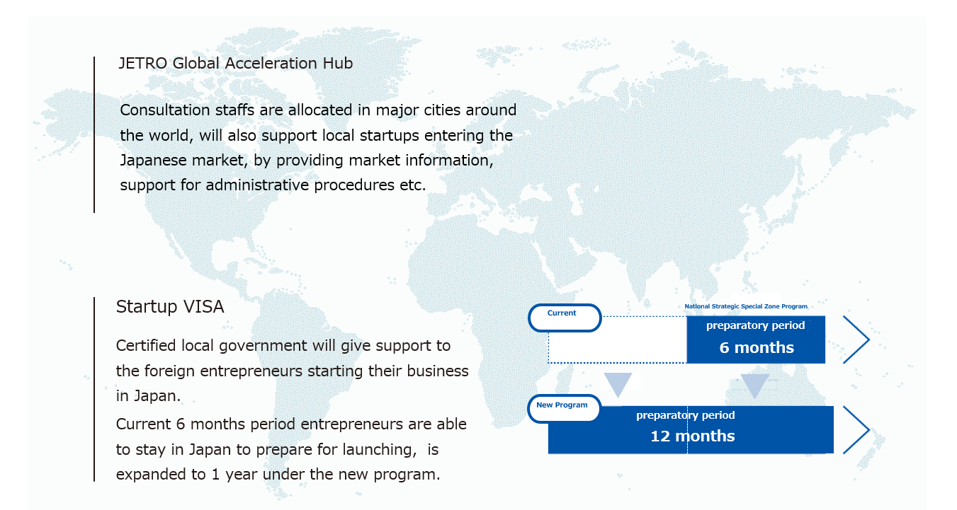
Inbound
Attracting cutting edge entrepreneurs from around the world.
© 2018 Ministry of Economy, Trade and Industry.

Slide 8
J-Startup Companies
１／２
ABEJA
AI SILK
Aillis.
AISing
akippa
ALE
Alivas
AlpacaJapan
alt
ARAYA
ArchiTek
Asilla
ASOVIEW
Astroscale
AWAKENS
Axelspace
Ball Wave
BIOME
BizReach
BizteX
Braizon Therapeutics
C Channel
Caddi
Caulis
Challenergy
Cinnamon
COCOA MOTORS
Cogent Labs
CONNECTEC JAPAN
Connected Robotics
CrowdWorks
CureApp
CYBERDYNE
Cyfuse Biomedical
DG TAKANO
EdiGENE
Elephantech
Empath
Euglena
EXAWIZARDS
Farmship
Fermenstation
Finc
FLOSFIA
Fringe81
Global Mobility Service
GRA
GROOVE X
Himuka AM Pharma
Holoeyes
Homura Heavy Industries
Idein
Inagora
Infostellar
InstaVR
Integral Geometry Science
i-plug
iQPS
ispace
JEPLAN
JTOWER
Kotozna
Kyoto Robotics
Kyulux
LeapMind
Lequio Power Technology
Life is Tech !
Lily MedTech
LinkWiz
© 2018 Ministry of Economy, Trade and Industry.

Slide 9
J-Startup Companies
２／２
SmartNews
SORABITO
Spacelink
Spiber
Studio Ousia
SuRaLa Net
Sustainable Medicine
SYMAX
Synamon
TELEXISTENCE
Terra Motors
ThinkCyte
Tier IV
Trigence Semiconductor
Triple W Japan
tsumug
UZABASE
Vacan
visasQ
VISITS Technologies
WAmazing
WHILL
YUKAI Engineering
ZMP
μLab
Liquid
Lpixel
Luup
Luxonus
MAMORIO
Material Concept
mediVR
Medmain
Megakaryon
MELTIN MMI
Mercari
MetaGen
Metcela
Microwave Chemical
Mirrativ
MONEY DESIGN
Money Forward
MUJIN
MUSCA
Nanoegg
O:
OPTIMIND
P Mind
Panair
PeptiDream
Photo electron Soul
Pixie Dust Technologies
PKSHA Technology
PLANTIO
POLAR STAR SPACE
Preferred Networks
Quantum Biosystems
Raksul
Rapyuta Robotics
ReasonWhy
RegCell
ReproCELL
RIVERFIELD
Routrek Networks
Safie
Sansan
SENSYN ROBOTICS
SkyDisc
SmartDrive
SmartHR

Slide 10
J-Startup Companies
Overview

Slide 11
J-Startup Supporters
© 2018 Ministry of Economy, Trade and Industry.
Notes:
10月末時点で132社が参加。

Slide 12
J-Startup Supporters
Archetype
iEducation
IF Lifetime Ventures
AXA Life Insurance
ABBALab
ITOCHU Technology Ventures
Incubate Fund
Inclusion Japan
INDEPENDENTS CLUB
Wiz group
WiL
WERU Investment
Uchida & Samejima Law Firm
A.T. Kearney
edge of
NTT DATA
NTT DOCOMO
MT Partners
Oki
Omron
Olympus
KAPION
Culture Convenience Club
QB Capital
Kyoto Research Park
Kirin
Google
Creww
Global Brain
Globis Capital Partners
Globis University
IGPI
KSP
KDDI
KONICA MINOLTA
Samurai Incubate
SHARP
Japan Innovation Network
JAFCO
Johnson & Johnson Innovation
Ernst & Young ShinNihon
Sumitomo Life Insurance
SEIKO EPSON
01 Booster
Softbank
SB Innoventure
Sompo Japan Nipponkoa Insurance
The Dai-ichi Life Insurance
DNP
Daiwa securities
Takeda Pharmaceutical Company
Mitsubishi Tanabe Pharma Corporation
TDK
TX Entrepreneur Partners
Deloitte Tohmatsu Venture Support
Tokio Marine Holdings
Tokyo Gas
TOKYU CORPORATION
UTEC
DOGAN β
Draper Nexus Venture Partners, LLC
DRONE Fund
Nissei Capital
IBM Japan
Japanese Organization for Medical Device Development (JOMDD)
Nippon Life Insurance Company
The Japan Research Institute
Microsoft Japan
Japan Post
Japan Society of Clinical Research
Nomura Holdings
HEART CATCH
Panasonic
B Dash Ventures
PwC
NTT East
Beyond Next Ventures
500 Startups Japan
Fast Track Initiative
Phillips Japan
Fujitsu
Future Venture Capital
Plug and Play, Japan
Project Nippon
Venture Café Tokyo
MAEDA CORPORATION
NIPPON STEEL KOWA REAL ESTATE CO.,LTD.
Mistletoe
MIZUHO Bank
MIZUHO Securities
SMBC
Mitsubishi Estate Company
Mitsubishi UFJ Capital Company
MUFG Bank
Miyako Capital
MedVenture Partners
Mori Building Company
Real Tech Fund
LINK-J/ Mitsui Fudosan
Ricoh
Leave a Nest
Rheos Capital Works
Regus Japan
ROHTO Pharmaceutical Company
Loftwork
East Japan Railway Company
SBI Investment
SMBC Venture Capital
Spiral Ventures/Spiral Ventures Japan
SMBC NIKKO SECURITIES
KPMG AZSA
Sony Bank
Recruit Management Solutions
KADOKAWA ASCII Research Laboratories
The Kansai Electric Power Company
Mitsubishi UFJ Morgan Stanley
Accenture Japan
SPARX Group
Mitsui Sumitomo Insurance
TOPPAN PRINTING
Amazon Web Services Japan
DMM.com
MEIJI YASUDA LIFE INSURANCE COMPANY
Keio Innovation Initiative
TEPCO Ventures
ProtoStar
Sony Corporation
SEKISUI CHEMICAL
Socionext Inc.
Yaskawa Electric Corporation
© 2018 Ministry of Economy, Trade and Industry.

Slide 13
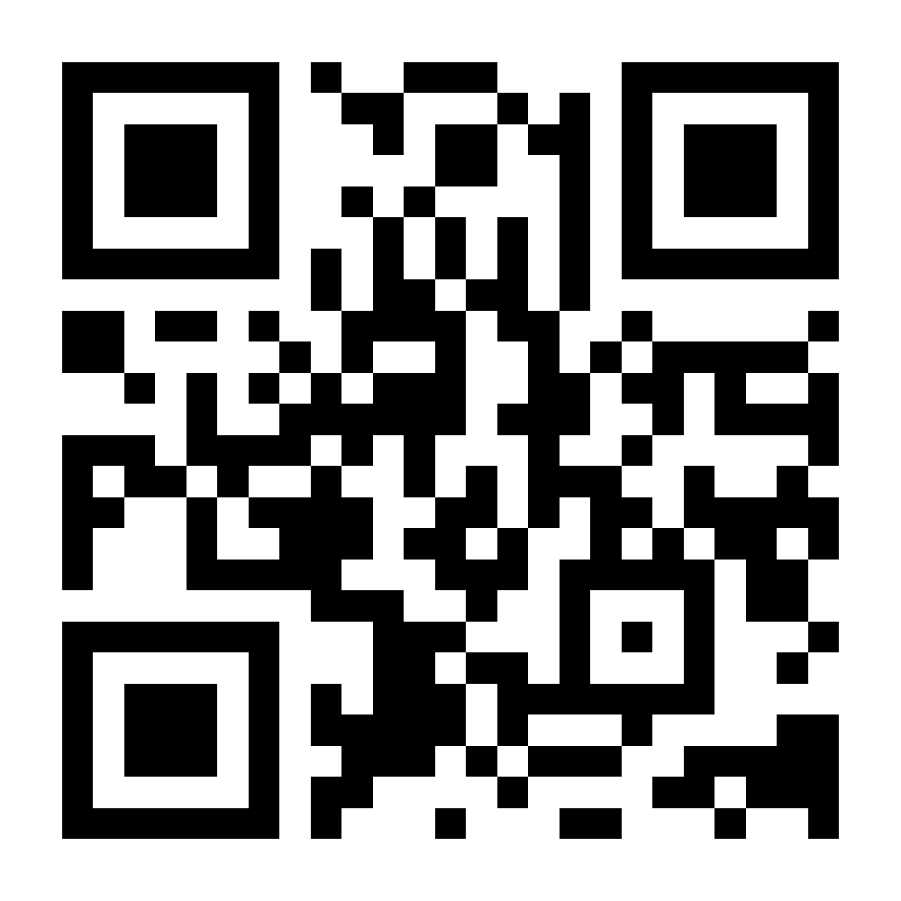
Secretariat：Ministry of Economy, Trade and Industry Startup and New Business Promotion Office, Economic and Industrial Policy Bureau
〒100-8901 Kasumigaseki 1-3-1, Chiyoda-ku,TOKYO
Call：+81-3-3501-1569
Mail:METI_J-Startup@meti.go.jp
Secretariat：Japan External Trade Organization, Innovation promotion Division
〒107-6006 6F Ark Mori Building 12-32-1 Akasaka Minato-ku TOKYO
Call：+81-3-3582-5770
Mail:JETRO_J-Startup@jetro.go.jp
Secretariat：New Energy and Industrial Technology Development Organization, Innovation Promotion Department
〒212-8554 20F Muza Kawasaki Central Tower, 1310 Omiya-cho, Saiwai-ku Kawasaki City, KANAGAWA
Call：+81-44-520-5173
Mail:NEDO_J-Startup@nedo.go.jp
© 2018 Ministry of Economy, Trade and Industry.

